Slide 1
Stranded by Carbon Risk
Prof.dr. Dirk Brounen
Tilburg University

Slide 2
Lost in translation
We all know about:
Climate change
Real estate’s CO2 emissions
Paris, COP21
But what does it mean?
To you
Today

Slide 3
Climate policy implications
COP21 means:
40% lower gHg emissions by 2030
80% lower gHg emissions by 2050
Enforcement in this data transparent era comes in various shapes and forms:
Tax penalties
Bans on rent
Climate risk will affect your property values
–> create an additional source of stranded asset risk

Slide 4
The Carbon Risk Real Estate Monitor
1. We translate long-term policies into clear science based targets
Global -> National
National -> Real estate industry
Real estate industry -> Sectors
gHg
intensity
Policy pathway
2030
2050

Slide 5
The Carbon Risk Real Estate Monitor
1. We translate long-term policies into clear science based targets
Global -> National
National -> Real estate industry
Real estate industry -> Sectors
2. Position you into the most relevant policy pathway
gHg
intensity
Carbon stranded asset risk
2030
2050

Slide 6
The Carbon Risk Real Estate Monitor
1. We translate long-term policies into clear science based targets
Global -> National
National -> Real estate industry
Real estate industry -> Sectors
2. Position you into the most relevant policy pathway
3. Determine your time to carbon stranded asset risk exposure
gHg
intensity
Carbon stranded asset risk
2027
2030
2050

Slide 7
The Carbon Risk Real Estate Monitor
1. We translate long-term policies into clear science based targets
Global -> National
National -> Real estate industry
Real estate industry -> Sectors
2. Position you into the most relevant policy pathway
3. Determine your time to carbon stranded asset risk exposure
4. Help you consider steps to reduce your stranded carbon risk exposure
gHg
intensity
2027
2030
2040
2050

Slide 8
The Carbon Risk Real Estate Monitor
Helps you to identify the carbon policy measures, most relevant to you
Will quantify your exposure to carbon stranded asset risk
Helps you time retrofits, and align these with future policy implications

Slide 9
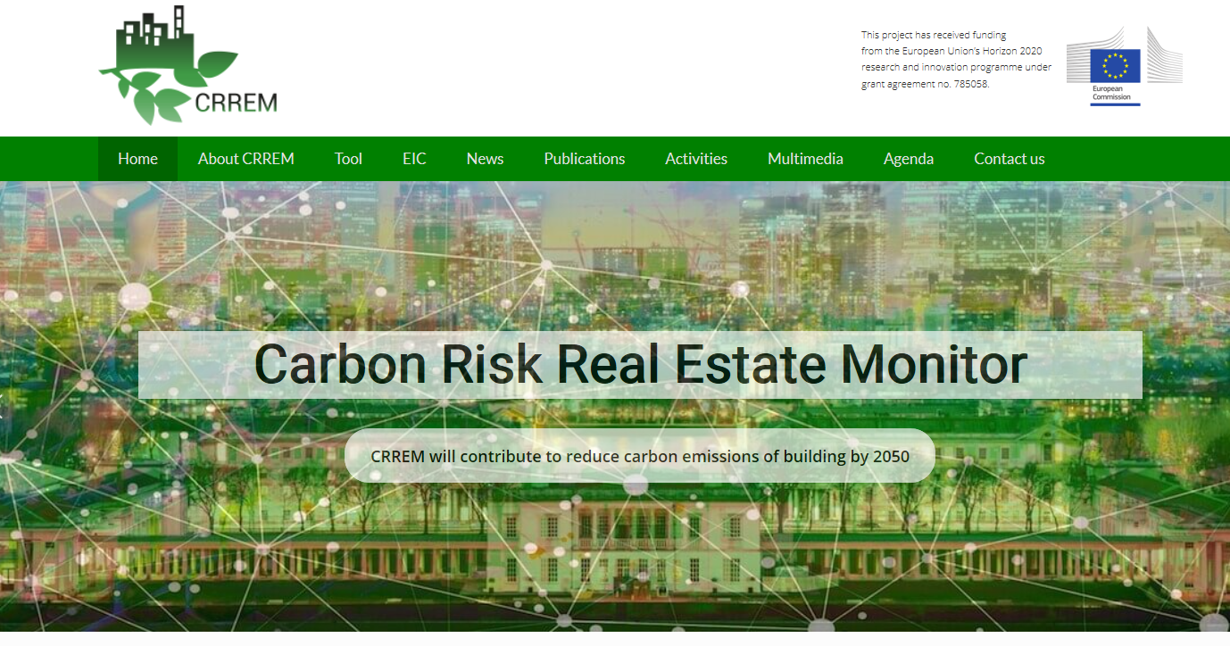
My Oprah moment
All of you can use the CRREM tool,
for free
One more thing…
Your investors will also be using the CRREM tool for free
www.crrem.eu

